Slide 1
Reviving Token-based Replay: Increasing Speed While Improving Diagnostics
ATAED 2019
Alessandro Berti, Wil van der Aalst

Slide 2


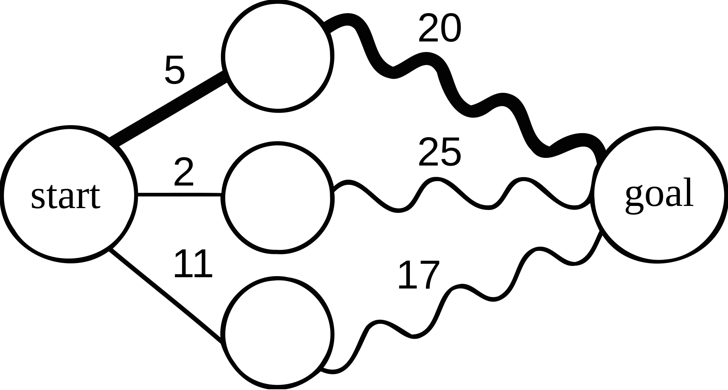

Outlook of the Paper
(1) The abandoned replay technique
(2) Motivations for re-introduction
(3) Technique
(4) Results

Slide 3
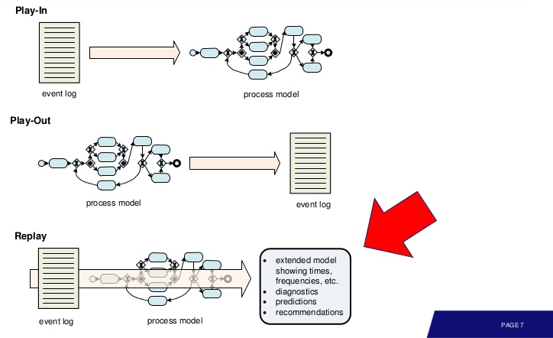
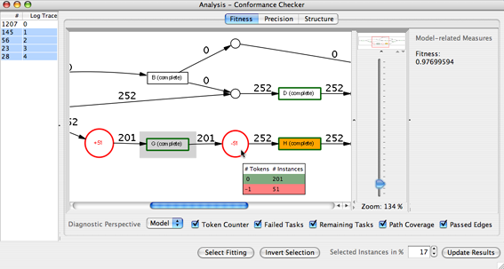
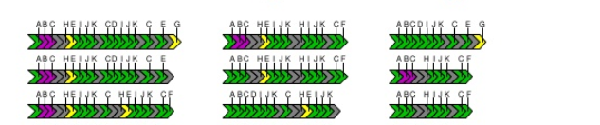
Replay Techniques
Ways to match the process model elements with the log events.
Two techniques are “mainstream”: token-based replay and alignments

Slide 4
Token-based Replay: an abandoned technique
Leading replay technique in ProM4/ProM5.
Can handle any accepting Petri net.
Fast if the model does not contain invisible transitions.
Several problems:
  P1 - Management of invisible transitions
  P2 - Token flood

Slide 5
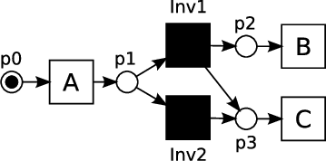
(P1) Handling of invisible transitions
Trace <A,C>: C could be reached firing Inv2.
To discover that, the token-based replay implementation in ProM5 explores locally the state-space.
Heuristics are adopted to choose the paths to explore.

Slide 6
(P2) Token flood problem
p1
p2
p3
A
B
C
D
Simple example.
Replaying trace <A,D,B,C,D> requires the insertion of a missing token in p3.
When the missing token gets inserted, we have two tokens in the model. For more complex models, this can cause problems.

Slide 7
(P2) Token flood problem
p1
p2
p3
A
B
C
D
Simple example.
Replaying trace <A,D,B,C,D> requires the insertion of a missing token in p3.
When the missing token gets inserted, we have two tokens in the model. For more complex models, this can cause problems.

Slide 8
(P2) Token flood problem
p1
p2
p3
A
B
C
D
Missing (1)
Simple example.
Replaying trace <A,D,B,C,D> requires the insertion of a missing token in p3.
When the missing token gets inserted, we have two tokens in the model. For more complex models, this can cause problems.

Slide 9
(P2) Token flood problem
p1
p2
p3
A
B
C
D
Simple example.
Replaying trace <A,D,B,C,D> requires the insertion of a missing token in p3.
When the missing token gets inserted, we have two tokens in the model. For more complex models, this can cause problems.

Slide 10
(P2) Token flood problem
p1
p2
p3
A
B
C
D
Simple example.
Replaying trace <A,D,B,C,D> requires the insertion of a missing token in p3.
When the missing token gets inserted, we have two tokens in the model. For more complex models, this can cause problems.

Slide 11
(P2) Token flood problem
p1
p2
p3
A
B
C
D
Simple example.
Replaying trace <A,D,B,C,D> requires the insertion of a missing token in p3.
When the missing token gets inserted, we have two tokens in the model. For more complex models, this can cause problems.

Slide 12
(P2) Token flood problem
p1
p2
p3
A
B
C
D
Simple example.
Replaying trace <A,D,B,C,D> requires the insertion of a missing token in p3.
When the missing token gets inserted, we have two tokens in the model. For more complex models, this can cause problems.

Slide 13
Outlook of the Paper
(1) The „abandoned“ replay technique
(2) Motivations for re-introduction
(3) Technique
(4) Results

Slide 14
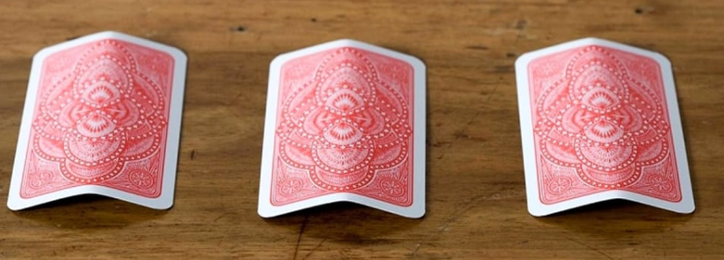
Alignments approach is inherently slower
Much work in recent years:
  Heuristics.
  Decomposing/
  Recomposing.
But for its nature, an optimal alignment implementation is slower than an optimal token-based replay.
Playing with 3 cards (sync, move on model, move on log) rather than with 2.

Slide 15
Outlook of the Paper
(1) The „abandoned“ replay technique
(2) Motivations for re-introduction
(3) Technique
(4) Results

Slide 16
New approach of token-based replay (1)
Reason about places, not markings!
Prior to the replay, memorize a map of shortest paths containing only invisibles between places.

Slide 17
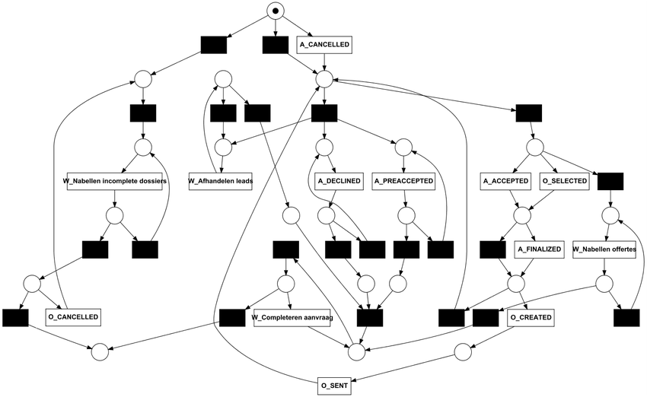
New approach of token-based replay (2)
When a transition cannot fire, reason about places not about markings.
Try to use the shortest paths between places, possibly several times, to reach a marking where the transition can fire.
While the approach work on any accepting Petri net, it provides the biggest performance gains in models with long chains of invisibles (Inductive Miner, Heuristics Miner, Split Miner).

Slide 18
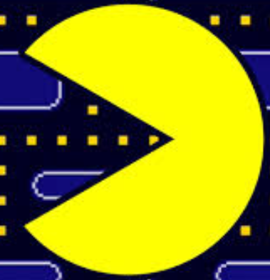
Solution for the token flood!
Using structural properties of the provided model.
Answer to question: how many tokens can be in a place? (S-components, place bounds).
If during the token based replay there are more tokens than allowed, freeze superfluous tokens.

Slide 19
Example – Token flood solution
p1
p2
p3
A
B
C
D
Replaying trace <A,D,B,C,D>, token in p1 is frozen after insertion of the missing token in p3 (to execute the first instance of D).
Why this?
So, M=2 (two missing tokens), R=0 and F=1 (frozen).

Slide 20
Example – Token flood solution
p1
p2
p3
A
B
C
D
Replaying trace <A,D,B,C,D>, token in p1 is frozen after insertion of the missing token in p3 (to execute the first instance of D).
Why this?
So, M=2 (two missing tokens), R=0 and F=1 (frozen).

Slide 21
Example – Token flood solution
p1
p2
p3
A
B
C
D
Missing (1)
Replaying trace <A,D,B,C,D>, token in p1 is frozen after insertion of the missing token in p3 (to execute the first instance of D).
Why this?
So, M=2 (two missing tokens), R=0 and F=1 (frozen).

Slide 22
Example – Token flood solution
p1
p2
p3
A
B
C
D
Replaying trace <A,D,B,C,D>, token in p1 is frozen after insertion of the missing token in p3 (to execute the first instance of D).
Why this?
So, M=2 (two missing tokens), R=0 and F=1 (frozen).

Slide 23
Example – Token flood solution
p1
p2
p3
A
B
C
D
Missing (2)
Replaying trace <A,D,B,C,D>, token in p1 is frozen after insertion of the missing token in p3 (to execute the first instance of D).
Why this?
So, M=2 (two missing tokens), R=0 and F=1 (frozen).

Slide 24
Example – Token flood solution
p1
p2
p3
A
B
C
D
Replaying trace <A,D,B,C,D>, token in p1 is frozen after insertion of the missing token in p3 (to execute the first instance of D).
Why this?
So, M=2 (two missing tokens), R=0 and F=1 (frozen).

Slide 25
Example – Token flood solution
p1
p2
p3
A
B
C
D
Replaying trace <A,D,B,C,D>, token in p1 is frozen after insertion of the missing token in p3 (to execute the first instance of D).
Why this?
So, M=2 (two missing tokens), R=0 and F=1 (frozen).

Slide 26
Example – Token flood solution
p1
p2
p3
A
B
C
D
Replaying trace <A,D,B,C,D>, token in p1 is frozen after insertion of the missing token in p3 (to execute the first instance of D).
Why this?
So, M=2 (two missing tokens), R=0 and F=1 (frozen).

Slide 27
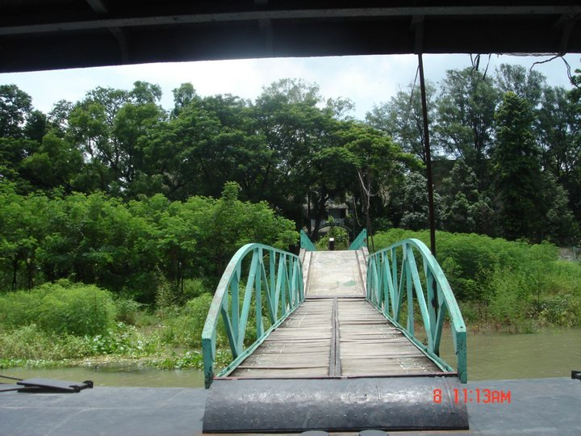
Taking implementation tricks „on the other side of the river“
Postfix caching: a trick taken from the alignments implementation of ProM6.
The choices done are the same if the marking and the remaining postfix is the same.
New concept for TR: activity caching. The choices done (invisibles) are the same if the marking and the target activity is the same.

Slide 28
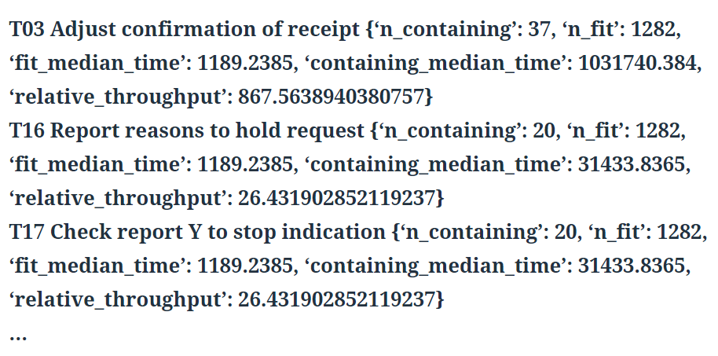
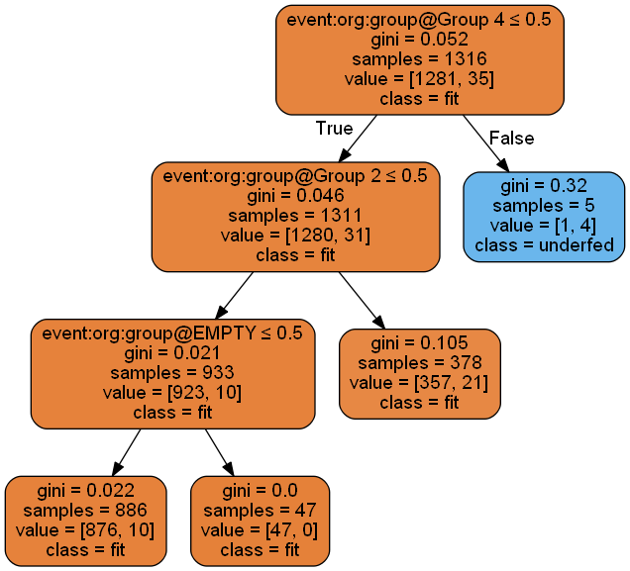
Diagnostics
Some diagnostics were implemented only for alignments.
Similar approaches could be used also for token-based replay (e.g., storing the incremental case history along with the replay).

Slide 29

Implementation
PM4Py Python process mining library.
Documentation: http://pm4py.pads.rwth-aachen.de/documentation/conformance-checking/token-based-replayer/
Diagnostics: http://pm4py.pads.rwth-aachen.de/documentation/conformance-checking/token-based-replayer/token-based-replay-diagnostics/

Slide 30
Outlook of the Paper
(1) The „abandoned“ replay technique
(2) Motivations for re-introduction
(3) Technique
(4) Results

Slide 31
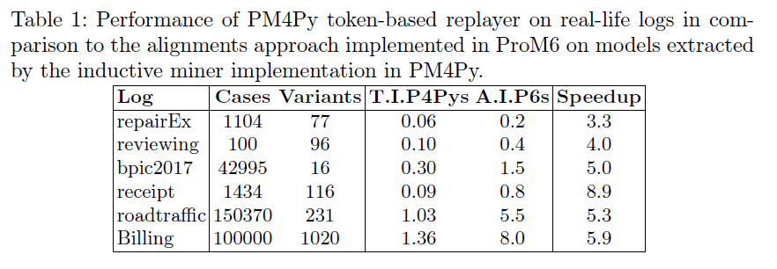
Performance
T.I.P4Pys
=
Execution time
of the token
based replay
in PM4Py
A.I.P6s
=
Execution time
of the alignments
in ProM6

Slide 32
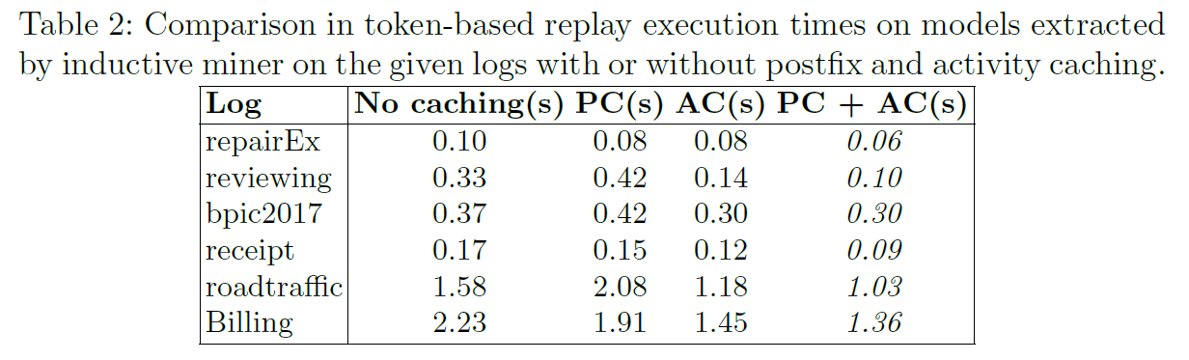
Effectiveness of the postfix/activity caching tricks

Slide 33
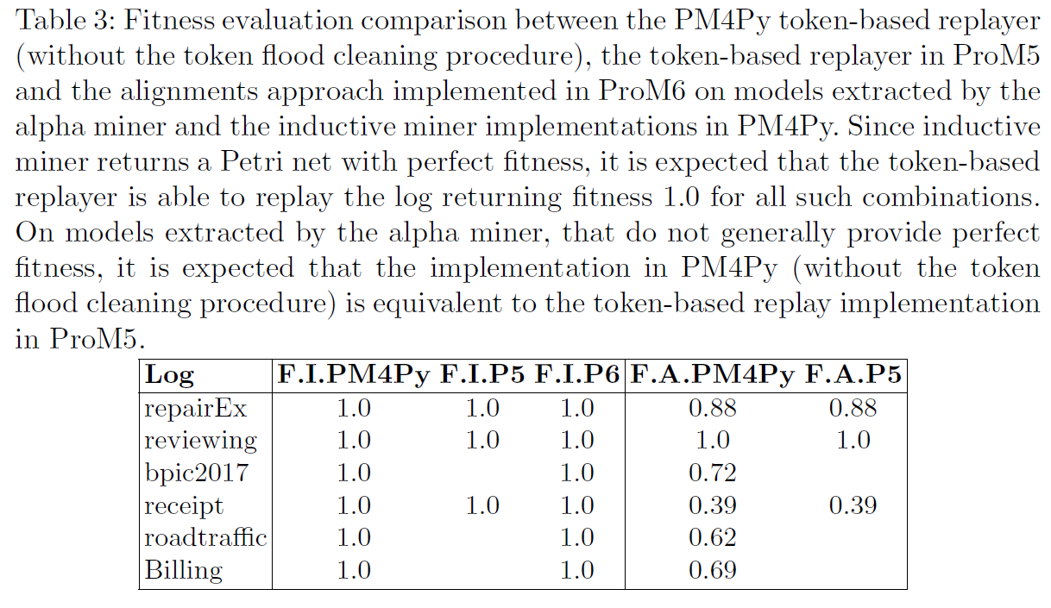
Fitness comparison
Left side=
Model extracted by
Inductive Miner
Fitness TBR PM4Py
Fitness TBR ProM4/5
Fitness Alignments ProM6
Right side=
Model extracted by Alpha Miner
Fitness TBR PM4Py
Fitness Alignments ProM6

Slide 34
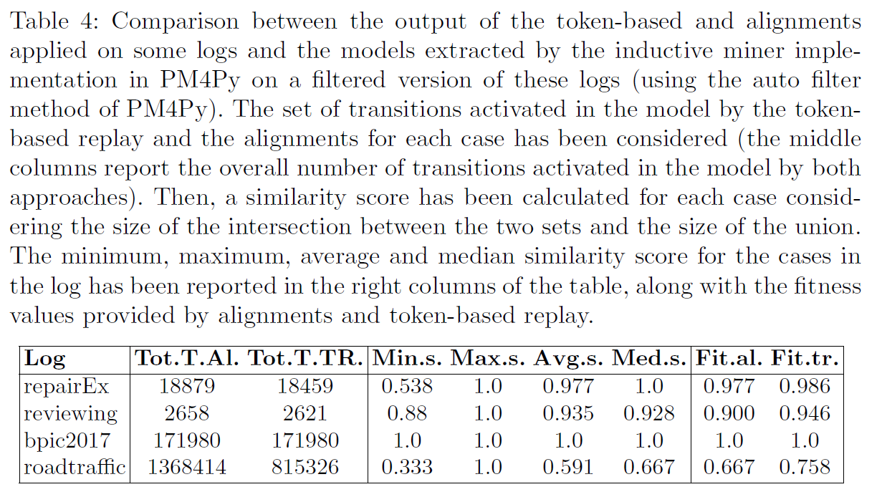
Comparison of the enabled transitions

