Slide 1



ATAED Aachen June 25, 2019
How to cope
with event data
of BIG systems?
Wolfgang Reisig
Humboldt-Universität
zu Berlin
Prof. Dr. W. Reisig

Slide 2
How to cope with event data of BIG systems?
System must be modeled
Models must be composed.

Slide 3
1. Systems must be modeled
Models are mined …

Slide 4
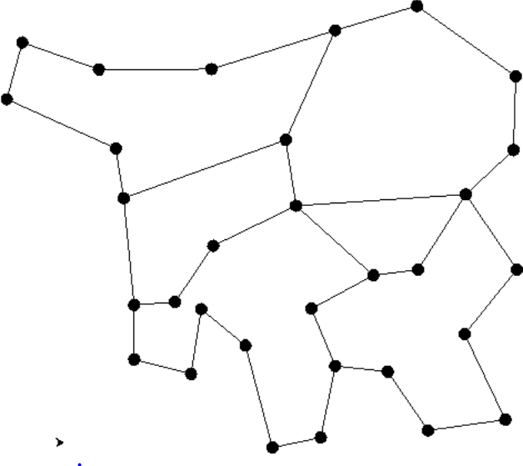
What is a good model?
Example: PubSub migration*
Given:
A computer network
Some nodes serve as
coordinators for clients.
A “source” client wants to become
a “target” client of another coordinator.
The coordinators may
grant or decline this wish.
The nodes communicate …
target
source
* by Arno Jacobsen

Slide 5
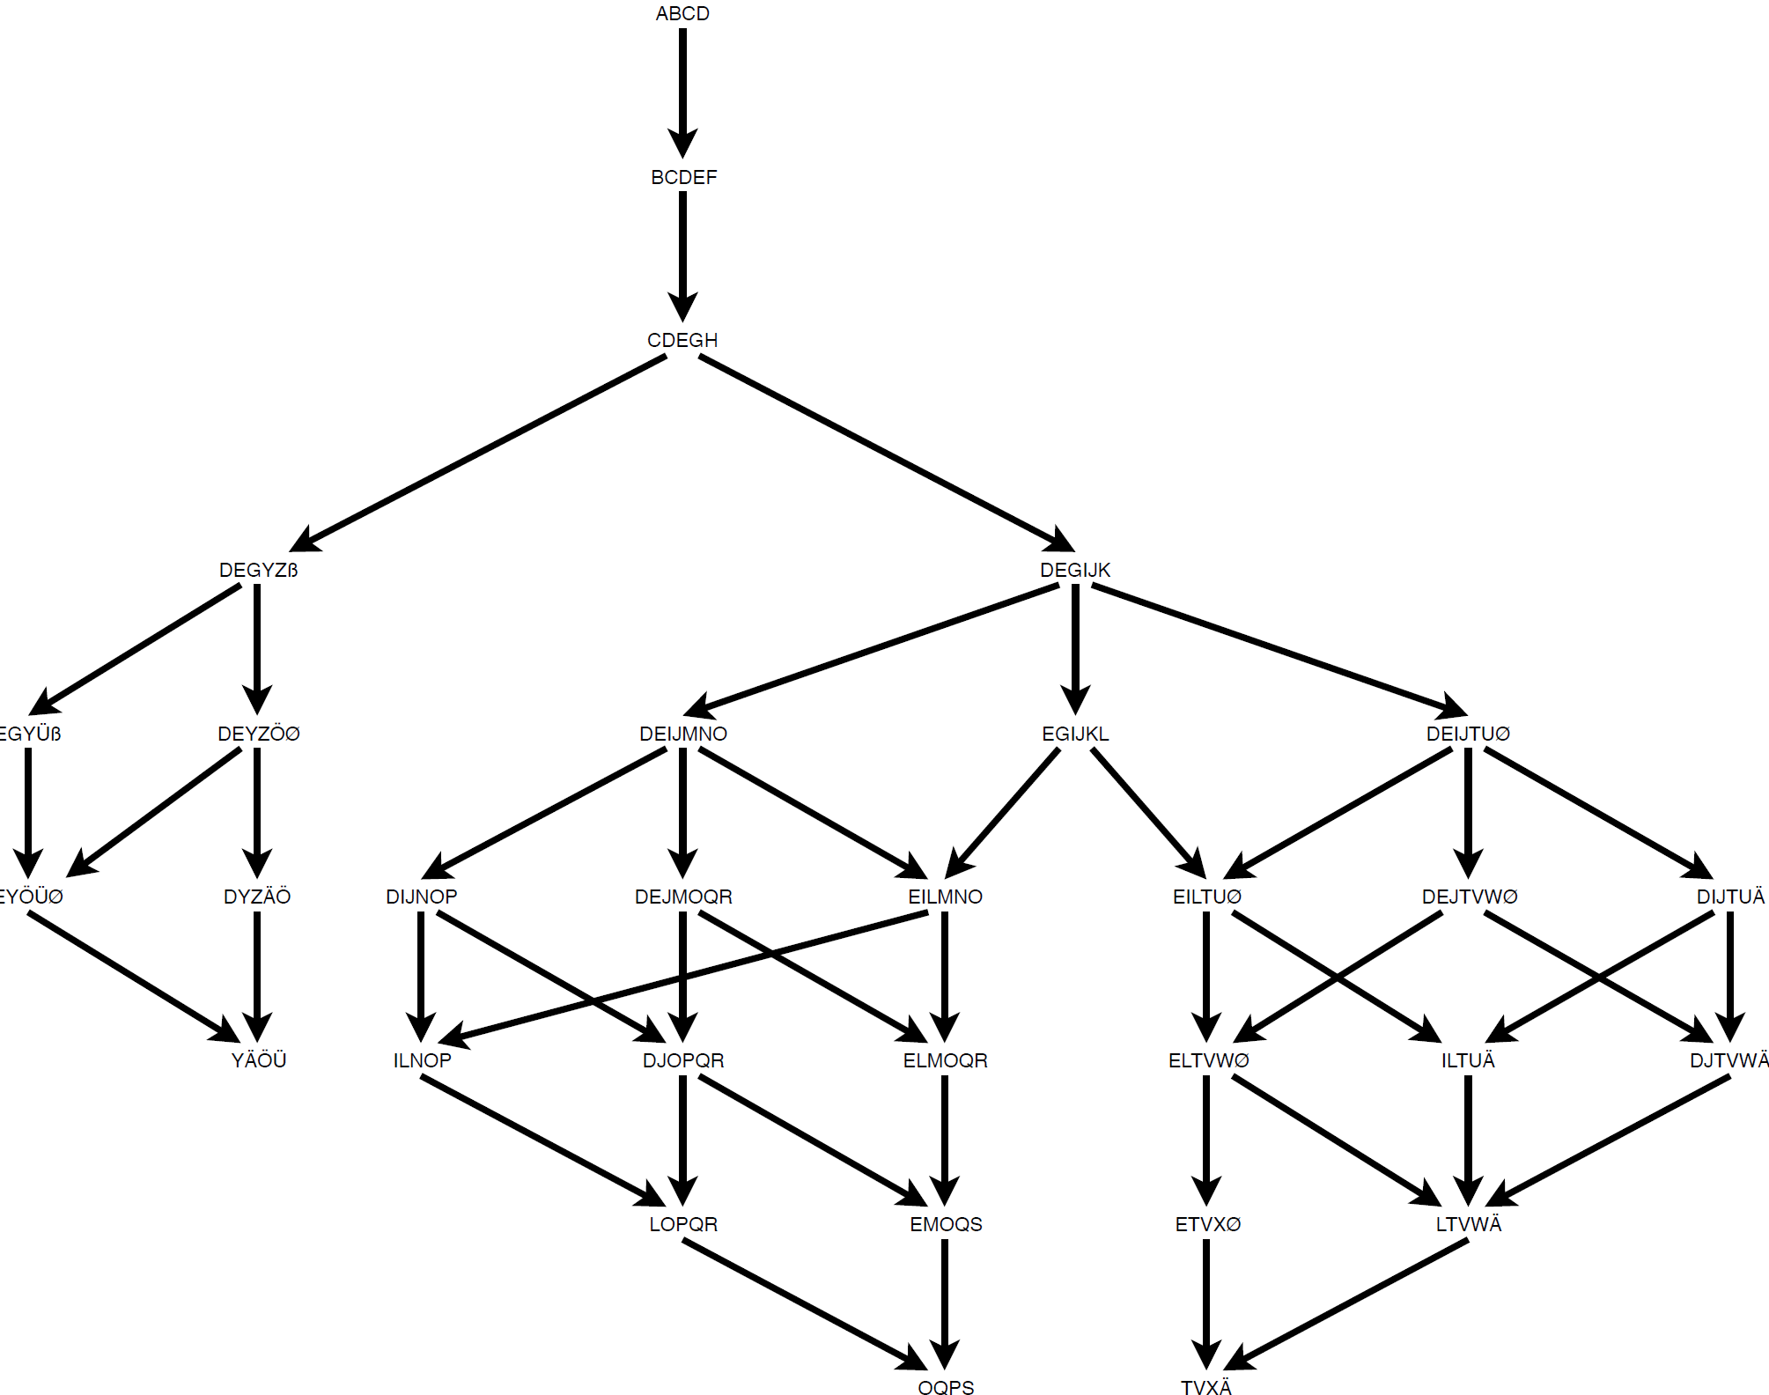
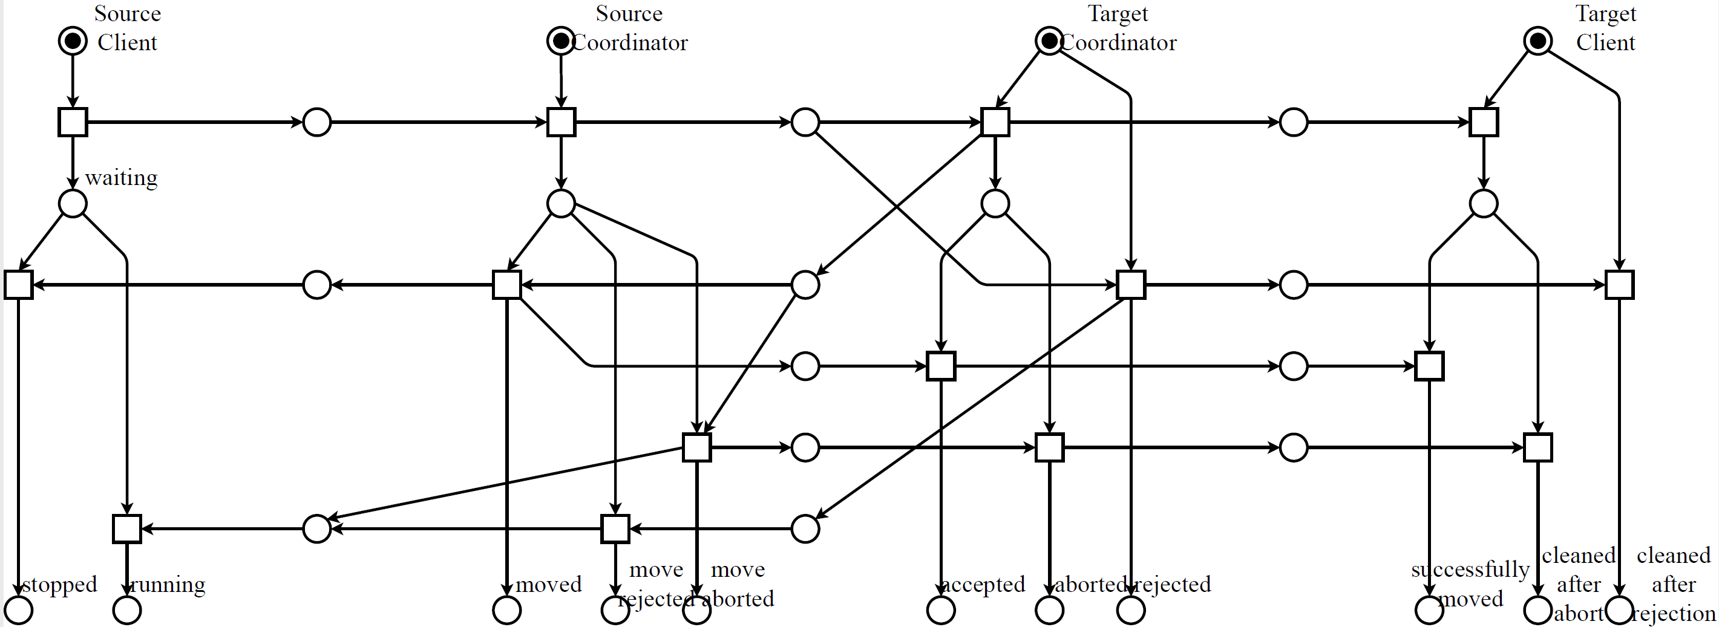
What is a good model?
Example: PubSub migration*
The algorithm as a finite state machine:
In a technical sense, they are equivalent.
How important is the graphical layout?
Can you mine the layout?
and as a Petri net:

Slide 6
What is a good model?
Example: PubSub migration*
So, why is the Petri net “better”?
1. It exhibits control

Slide 7
What is a good model?
Example: PubSub migration*
So, why is the Petri net “better”?
1. It exhibits control

Slide 8
What is a good model?
Example: PubSub migration*
So, why is the Petri net “better”?
1. It exhibits control

Slide 9
What is a good model?
Example: PubSub migration*
So, why is the Petri net “better”?
1. It exhibits control

Slide 10
What is a good model?
Example: PubSub migration*
So, why is the Petri net “better”?
2. It localizes alternatives

Slide 11
What is a good model?
Example: PubSub migration*
So, why is the Petri net “better”?
2. It localizes alternatives

Slide 12
What is a good model?
Example: PubSub migration*
So, why is the Petri net “better”?
2. It localizes alternatives

Slide 13
What is a good model?
Example: PubSub migration*
So, why is the Petri net “better”?
2. It localizes alternatives

Slide 14
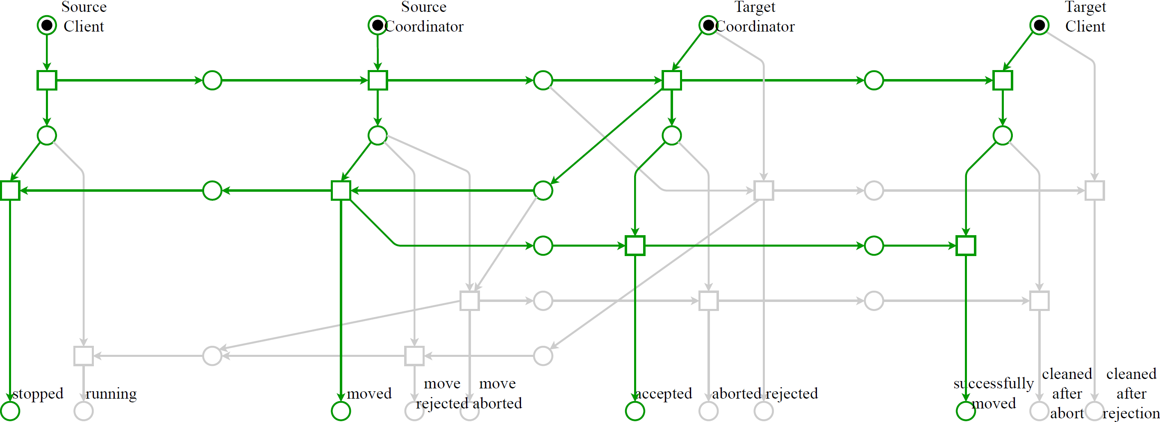
So, why is the Petri net “better”?
3. It exhibits the three behaviors:
Green: successful move
What is a good model?
Example: PubSub migration*

Slide 15
So, why is the Petri net “better”?
3. It exhibits the three behaviors:
Blue: target coordinator rejects
What is a good model?
Example: PubSub migration*

Slide 16
So, why is the Petri net “better”?
3. It exhibits the three behaviors:
Red: target coordinator accepts, then source coordinator aborts
What is a good model?
Example: PubSub migration*
Three partially ordered behaviors
21 paths through the state machine

Slide 17
What is a good model?
Example: PubSub migration*
Finally, make the first transition cold
cold
Can you mine
the structure of a system?
its cold/hot transitions?
its nonsequential processes?

Slide 18
What is a good model?
Example: PubSub migration*
… redundant messages:
Ideas:
Mind the nonsequential processes; then derive the system model.
Find redundancies
by means of regions.

Slide 19
2. Models must be composable
Structure: frequently hierarchical.
To this end, required:
Canonical, universal principles,
independent of semantical details.
Specification: abstract
Implementation: refined
Required property:
specification implies implementation
Refinement calculus, encapsulation, …
Large systems:
Computer architectures,
Embedded systems,
Business information systems,
Information infrastructures,
The internet of people, things, services and events.
A large system is structured.

Slide 20
2. Models must be composable
Structure: frequently composed, shaped
A₁ • A₂ • … • A_{n} , with components A_{i} .
Structure: frequently hierarchical
To this end, required:
Canonical, universal principles,
independent of semantical details.
Large systems:
Computer architectures,
Embedded systems,
Business information systems,
Information infrastructures,
The internet of people, things, services and events
A large system is structured.

Slide 21
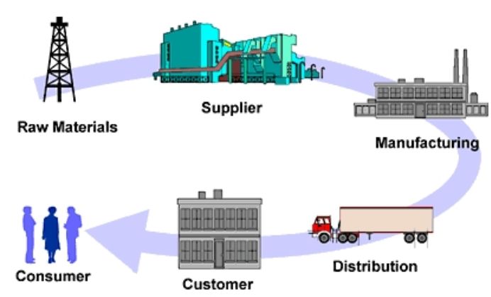
Example: A supply chain
Structure: frequently composed, shaped
A₁ • A₂ • … • A_{n} , with components A_{i} .
Structure: frequently hierarchi
To this end, required:
Canonical, universal principles,
independent of semantical details.
Event based systems: PubSub
SOC: provider/requester/broker
So, what are (the) fundamentals
of composition?
RM • Su • Ma • Di • Cu • Co

Slide 22
Let‘s start with components
Structure: frequently composed, shaped
A₁ • A₂ • … • A_{n} , with components A_{i} .
Structure: frequently hierarchi
To this end, required:
Canonical, universal principles,
independent of semantical details.
A component consists of
its interface and
its inner structure.
Interface: strict, formal.
Inner structure: liberal.
Composition: formal;
dependig only on the interface.
RM • Su • Ma • Di • Cu • Co

Slide 23
Let‘s start with components
Structure: frequently composed, shaped
A₁ • A₂ • … • A_{n} , with components A_{i} .
Structure: frequently hierarchi
To this end, required:
Canonical, universal principles,
independent of semantical details.
Fundamental:
Composition is associative:
(A • B) • C = A • (B • C).
RM • Su • Ma • Di • Cu • Co
No
brackets!
Assumed without saying

Slide 24
An obvious start
An interface is
a set of labeled gates.
Composition:
Glue equally labelled gates,
remove them from
the interfaces.
r
(A • B)
• C
r
C
r
r
r
r
s
t
s
t
A
B
r
(B • C)
A•
• is not
associative!
r
r
s
t

Slide 25
Hoe solve this problem?
ignore it
restrict choice of labels
define „n-fold composition“
…
… our proposal:

Slide 26
A closer look:
Beispiel:
Frequently, the interface is 2-partitioned:
input and output,
customer and supplier,
requester and provider,
consumer and producer,
buy side and sell side,
predecessor and successor,
assumptions and guaranties,
pull and push,
etc.
RM • Su • Ma • Di • Cu • Co
A component C frequently has
a left and a right interface, *C und C*.
composition A • B:
Glue gates of A* und *B .

Slide 27
Fundamental idea
r
s
t
t
q
p
r
r
p
*A
A*
*B
B*
A
B
A component C frequently has
a left and a right interface, *C und C*.

Slide 28
Fundamental idea
r
t
t
r
D
s
s
t
t
q
q
p
r
r
p
p
r
r
p
*A
A*
*B
B*
*(A • B)
(A • B)*
A
B
A • B
A component C frequently has
a left and a right interface, *C und C*.
composition A • B:
Glue gates of A* und *B .

Slide 29
Fundamental idea
D
t
s
r
s
t
t
r
t
q
q
p
r
r
p
p
r
r
p
*A
A*
*B
B*
*(A • B)
(A • B)*
This composition
is associative!
A
B
A • B
A component C frequently has
a left and a right interface, *C und C*.
composition A • B:
Glue gates of A* und *B .

Slide 30
Example
producer
broker
client
nego-tiate
nego-tiate
send offer
a
a
rec. offer
send reject
a
a
b
b
reject offer
b
b
c
c
prod-uce
send order
accept offer
d
d
rec-eive
ship

Slide 31
Composition of several instances
2nd instance of N,
a. workflow model N
b. composed workflow model, N • N
workflow model, M
N • N • N • M
c. composed workflow model, N • N • N

Slide 32
… so, in mathematical terms …
Let be given a finite set Σ of symbols
“gate labels”. Then
an interface over Σ
is a finite, ordered set, labeled over Σ.
a component C over Σ
is any structure with
a left and a right interface,
*C und C*.
Let S_{Σ} denote the class of
all components over Σ .
Composition • then is defined on S_{Σ} .
Fundamental, not trivial:
Theorem. Composition • on S_{Σ} is
total and
associative.
Observation. With *E = E* = ∅,
A•E = E•A = A.
Corrollary.
M =_{def} (S_{Σ} , •, E) is a monoid
Exactly as in formal languages
Just replace „word over Σ“
by „component over Σ“

Slide 33
How can you do „everything“ with this?
Compose A and B
under side conditions
Conformance,
Interoperability,
Composability,
Semantic restrictions,
Data types,
Alternative gate matches,
Nondeterminism, …
formulate as an adapter C,
in A • C • B.
examples:
a
a
a
a
requirement: want to glue non-matching gates
b
b
b
b
A
adapter C
B
reqirement: nondeterministic choice
a
a
a
a
b
b
A
adapter D
B

Slide 34
Complex composition as Adapter
To express a property π
of a composition operator •_{π} :
Construct an adapter [π] ;
replace A •_{π} B by A • [π] • B .
Advantage (among others):
Composition of properties:
A • [π] • [π‘] • B .

Slide 35
Example: a small computer architecture
b
E
b
b
b
b
d
d
C
S
a
a
a
c
c
d
d
a
L
c
c
D
Sc
b
d
d
C
S
a
a
a
a
c
c
C client
L load balancer
S service
Sc scheduler
D data base
E editor
C • C • L • S • S • E • Sc • D
a messages from
client or load bal.
b messages to client
or editor
c message from
service or schedul.
d message to service
or schleduler

Slide 36
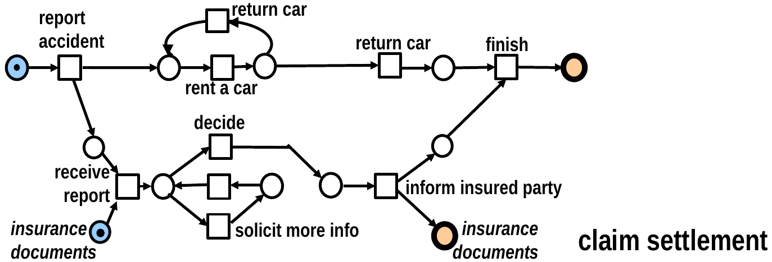
Preservation of properties
Example:
car rental
business process
at trafic jam
A, … F
are aparently sound
A•B•C•D•E•F
Is sound by construktion

Slide 37
BPMN
components

Slide 38
BPMN
Buyer • Reseller

Slide 39
BPMN
Buyer • Reseller • Payment Org

Slide 40
BPMN
Buyer • Reseller • Payment Org
• Manufacturer

Slide 41
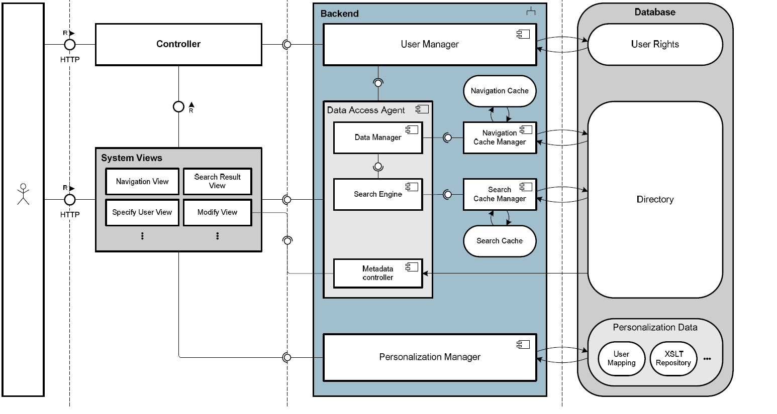
SAP:TAM Standardized Technical Architecture Modeling
Notes:
Standardized
Technical Architecture
Modeling
Conceptual and Design Level

Slide 42
Five components
Notes:
Standardized
Technical Architecture
Modeling
Conceptual and Design Level

Slide 43
composed
Five components
Notes:
Standardized
Technical Architecture
Modeling
Conceptual and Design Level

Slide 44
… so, what did we achieve, conceptually?
Canonical, universal principles for the
composition of components,
independent of their semantical contents.
Strict at the interface,
Liberal at the inner structure.
To start composition: distinguish
left and right interface.

Slide 45
3.3 The seams of a composed system
A canonical, universal principle
for composed systems
independent of
their semantical contents.
Motivted by
Interface description languages
DARWIN
RADL
AADL
Idea: specify the interface
before you program
the operations.
as well as
Early architecture description languages
Rapide
Wright
Weaves

Slide 46

The Problem
Let A =_{def} A₁ • A₂ • … • A_{n} .
How recompute from A all the A_{i} ?
In general: not possible.
Idea: store enough information
when composing the A_{i} !
.. the seam !.

Slide 47
… what to remember upon composition?

Slide 48
(d,e)
(i,k)
a
b
f
h
c
g
A
B
A•B
label: red, green, yellow

Slide 49
(d,e)
(i,k)
(d,e)
(i,k)
a
b
f
h
a
b
f
h
c
g
c
g
A
B
A
B
A•B
A•B

Slide 50
(d,e)
(i,k)
(d,e)
(i,k)
a
b
f
h
a
b
f
h
c
g
c
g
A
B
A
B
A•B
A•B

Slide 51
(d,e)
(i,k)
(d,e)
(i,k)
a
b
f
h
a
f
h
(b,g)
c
g
c
A
B
A
B
A•B
A•B

Slide 52
(d,e)
(i,k)
(d,e)
(i,k)
a
b
f
h
a
f
h
(b,g)
c
g
c
A
B
A
B
A•B
A•B

Slide 53
(d,e)
(i,k)
(d,e)
(i,k)
a
f
h
a
h
(b,g)
(b,g)
c
c
f
A
B
A
B
A•B
A•B

Slide 54
(d,e)
(i,k)
(d,e)
(i,k)
a
f
h
a
h
(b,g)
(b,g)
c
c
f
A
B
A
B
A•B
A•B

Slide 55
(d,e)
(i,k)
a
h
a
(d,e)
h
(b,g)
(b,g)
c
(i,k)
c
f
f
A
B
A
B
A•B
A•B

Slide 56
(d,e)
(i,k)
a
h
a
(d,e)
h
(b,g)
(b,g)
c
(i,k)
c
f
f
A
B
A
B
A•B
A•B

Slide 57
a
(d,e)
h
a
(d,e)
h
(b,g)
(b,g)
(i,k)
c
(i,k)
c
f
f
A
B
A•B
A•B

Slide 58
(d,e)
(i,k)
a
b
f
h
a
(d,e)
h
(b,g)
c
g
(i,k)
c
f
A
B
A•B
A•B
remember

Slide 59
… and now we decompose

Slide 60
Component C
*C und C* are bi-partitioned.
seam(C) is 3-partitioned.

Slide 62
A
B

Slide 63
A
B

Slide 64
Open questions
Can you mine component models?
With their interfaces?
For Petri nets:
Does region theory help
to identify interfaces?

Slide 65
ATAED Aachen June 25, 2019
Challenges for process mining:
Mind the nonsequential processes; then derive the system model.
Mind the structure of a system
Mind its cold/hot transitions
Mind components with their interfaces
Find redundancies
by means of regions.
How to cope
with event data
of BIG systems?
Wolfgang Reisig
Humboldt-Universität
zu Berlin
Prof. Dr. W. Reisig

