Slide 1
Email Analysis for Business Process Discovery
Nassim LAGA¹
Marwa ELLEUCH^{1,2}
Walid GAALOUL²
Oumaima ALAOUI ISMAILI¹
¹Orange Labs, France
²Télécom SudParis, Paris Saclay university, France

Slide 2
1
2
Propositions
Introduction: General Context & Motivations
3
Conclusion
4
Evaluation

Slide 3
1
2
Propositions
Introduction: General Context & Motivations
3
Conclusion
4
Evaluation

Slide 4
Introduction
Informal methods
Conversion into structured format
?
Process, Activity and Instance Recognition
Structured Event logs
Process Discovery = Process Model Generation
X
Fuzzy miner, Heuristic Miner, Alpha Algorithm
Hyp1: Have a structured format
Hyp2: Contain the trace of all BP tasks
X
Case id | Event | timestamp | Process | ….
0 | Position description | 16/03/2019 …
1 | Position description | 17/03/2019 …
…
Notes:
dfsgsgsgs

Slide 5
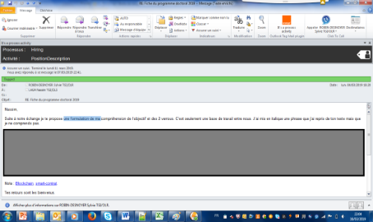
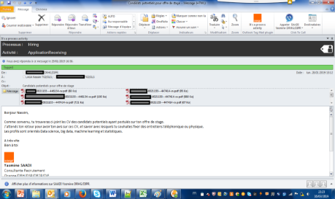
Introduction
Email log
Structured Event logs
Conversion into structured format
?
Case id | Event | timestamp | Process | ….
0 | Position description | 16/03/2019 … | Hiring
1 | Position description | 17/03/2019 … | Hiring
…
Process, Activity and Instance Recognition
Existing approaches
Learning based approaches: Supervised & Unsupervised
Labeling training dataset
Annotating clusters or tunining some parameters in the case of unsupervised learning
Pattern matching based approaches (e.g, semantic patterns to localize actions, actors and resources)
Manually defining paterns
Categories
Main limitation: Human intervention with time consuming tasks
Notes:
dfsgsgsgs

Slide 6
1
2
Propositions
Introduction
3
Conclusion
4
Evaluation

Slide 7
Propositions
Email log
Structured Event logs
Conversion into structured format
?
Case id | Event | timestamp | Process | ….
0 | Position description | 16/03/2019 … | Hiring
1 | Position description | 17/03/2019 … | Hiring
…
Process, Activity and Instance Recognition
Automatically identify one activity, one process and one instance related to each email using supervised learning and clustering techniques
Minimize human intervention by using:
Progressively learning approach that generates two types of predictive models for predicting process and activity names
Collaborative approach to build the learning dataset for training these predictive models => minimize the individual human effort
Non parametric clustering algorithm (Hdbscan) for identifying process instances
Notes:
dfsgsgsgs

Slide 8
Propositions
Unstructured email logs
Step1: Activity and Process Labels generation
Step2: Process Instance Detection
Progressively learning approach to train process and activity predictive models
Per process and per activity email lists
Clustering
Per process instance lists
Step3: Event Logs generation
Conversion bloc into structured format
Structured event logs
Notes:
dfsgsgsgs

Slide 9
Propositions
Unstructured email logs
Step1: Activity and Process Labels generation
Step2: Process Instance Detection
Progressively learning approach to train process and activity predictive models
Per process and per activity email lists
Clustering
Per process instance lists
Step3: Event Logs generation
Conversion bloc into structured format
Structured event logs
Notes:
dfsgsgsgs

Slide 10
Propositions
Collaborative annotation
Mini-batching learning
Process
Predictive
model
Features
- For predicting processes: Subject & Entities of email interlocutors
- For predicting activities: Subject & content & Entities of email interlocutors & Exchange History (short emails)
Unlabeled data
Labeled data
Activity
Predictive
models
Labeled data
Prediction
Unlabeled data
Step1: Activity and Process Labels Generation
Notes:
dfsgsgsgs

Slide 11
Propositions
Re-training
New batch of emails
Yes
If error_rate
> thresh
No
……….Email3,
Email2, Email1
End
Activity
Predictive
model
Error_rate calculation
Process
Predictive
models
Number of
manual correction
Preprocessing and selecting features
Manual correction
Detect and Replace Particular Expressions by a tag
Remove stop words and person Names
Lemmatize terms
Generate 1gram, 2gram vocabulary
Update word counters across the whole email dataset => Generate TFIDF Values
Generate Entities Interaction values
Predicted Labels
Adding the new batch to the whole dataset
Prediction
Pre-
processed
data
All existing emails (annotated and preprocessed)
Mini-Batching learning approach
Notes:
dfsgsgsgs

Slide 12
Propositions
Unstructured email logs
Step1: Activity and Process Labels generation
Step2: Process Instance Detection
Progressively learning approach to train process and activity predictive models
Per process and per activity email lists
Clustering
Per process instance lists
Step3: Event Logs generation
Conversion bloc into structured format
Structured event logs
Notes:
dfsgsgsgs

Slide 13
Propositions
Similarity function S between two emails E1 and E2 :
S(E1,E2) = W0 $\frac{|C\left(E1\right) ∩ C(E2)|}{|C\left(E1\right) ∪ C\left(E2\right)|}$+ W1 (1-$e^{−λ (ts\left(E1\right)−ts\left(E2\right))}$) + W2 $\frac{|NE\left(E1\right) ∩NE(E2)|}{|NE\left(E1\right) ∩NE(E2)|}$
Jaccard Distance between entity sets of emails’ interlocutors (C(E1) and C(E2)
Time Distance between E1 and E2 (ts = timestamp,
$λ=\frac{date_\max{− date_min}}{number_Of_emails}$ )
Jaccard Distance related to the named entities and references present in textual data of E1 and E2
W0, W1 and W2 are tuned by users according to the type of the process (e.g ; if it has time constraints such as the accounting closing process or not)
Notes:
dfsgsgsgs

Slide 14
Propositions
Unstructured email logs
Step1: Activity and Process Labels generation
Step2: Process Instance Detection
Progressively learning approach to train process and activity predictive models
Per process and per activity email lists
Clustering
Per process instance lists
Step3: Event Logs generation
Conversion bloc into structured format
Structured event logs
Notes:
dfsgsgsgs

Slide 15
1
2
Propositions
Introduction
3
Conclusion
4
Evaluation

Slide 16
Evaluation
Step1: Activity and Process Labels generation
Per process and per activity email lists
Step2: Process Instance Detection
Per process instance lists
Step3: Event Logs generation
Notes:
dfsgsgsgs

Slide 17
Evaluation
Step1: Activity and Process Labels generation
Per process and per activity email lists
Step2: Process Instance Detection
Per process instance lists
Step3: Event Logs generation
Number of emails : 1024
Number of activities: 116
Number of processes : 13 : Hiring, patent Application, Command, Conference Participation, travel expense refund, etc...
Testing 3 predictive algorithms:
Random forest (RF)
Logistic Regression (LR) with Stochastic Gradient Descent (SGD) optimiser
Support Vector Machine (SVM)
Algorithm | F1-Score
RF | 0.8072
LR with SGD | 0.8626
SVM | 0.8094
Evaluation Dataset
Evaluation
using F1-Score
Notes:
dfsgsgsgs

Slide 18
Evaluation
Step1: Activity and Process Labels generation
Per process and per activity email lists
Step2: Process Instance Detection
Per process instance lists
Step3: Event Logs generation
- Number of emails : 180
Process name : Hiring Process
Number of instance clusters: 11
Evaluation
Clustering Algorithm: HDBSCAN
Evaluation Metric: Adjusted mutual Information (AMI)
Returned Value $α$ $∈\left[0, 1\right]$
$α$ → 1 if real and Hdbscan partitions are strongly matched
$α$ → 0 if real and Hdbscan partitions are weakly matched
Evaluation Dataset
Evaluation Result:
$α$ = 0,86 → 1 => The real and Hdbscan partitions are strongly matched
Real partition
(Instance clusters Manually defined)
Notes:
dfsgsgsgs

Slide 19
Evaluation
Step1: Activity and Process Labels generation
Per process and per activity email lists
Step2: Process Instance Detection
Per process instance lists
Step3: Event Logs generation
Real Model
? Comparision
- Number of emails : 180
Process name : Hiring Process
Number of instance clusters: 11
Evaluation Dataset
Conversion into structured format
Applying the Heuristic Miner Algorithm
Discovered
Hiring Model
Notes:
dfsgsgsgs

Slide 20
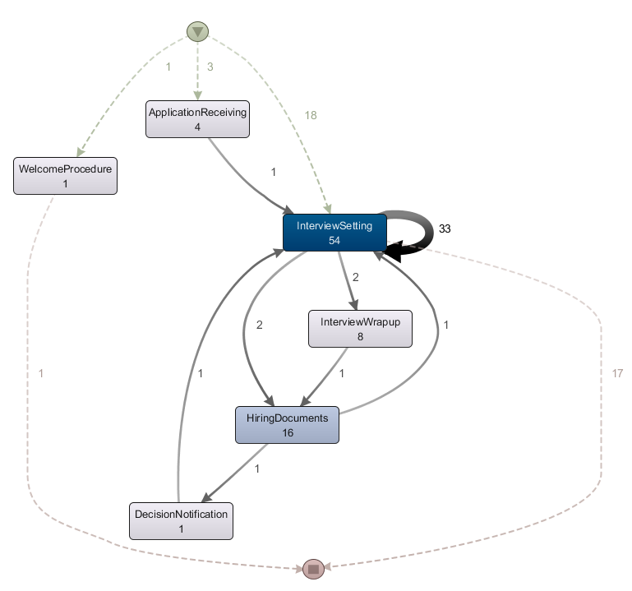
Evaluation
Real Hiring process Model
Discovered Hiring Model
Looping
Occurrence number over all process instances of each beahvior
Looping
X
Not allowed
behavior
Additional behavior
- Almost in conformity
- Two discrepancy types detected at low frequency :
(1) Unfitting model behavior (2) Additional model behavior
- Discrepancy Causes : Errors accumulated through the log building systems / Log miner technique / Real difference between the process as observed in the emails and the related theoretical BP model.
Notes:
dfsgsgsgs

Slide 21
1
2
Propositions
Introduction
3
Conclusion
4
Evaluation

Slide 22
Conclusion
Propositions & Advantages
A solution for mining business processes from emails
(+) The need of less human intervention at individual level compared to related works through the use of a collaborative learning approach and a non parametric clustering algorithm
(+) Good performances obtained after testing the overall approach on real dataset
Limitations & Perspectives
One Email can talk about more than one activity and more than one instance
The current approach still requires human involvement => More automate the BP discovery pipeline
Similarity meanings are not used => Employ similarity meaning measures for constructing learning features based on email contents
Notes:
dfsgsgsgs

Slide 23
Thanks for your attention

